Slide 1
High-Performance Python
Bismarck

Slide 2
Python’s Relevance

Slide 3
public class RNGooglePlacePickerModule extends ReactContextBaseJavaModule implements … {
public void onActivityResult(final Activity activity, final int requestCode, final int resultCode, …) {
if (mCallback == null || requestCode != REQUEST_PLACE_PICKER) {
return;
}
response = Arguments.createMap();
if (resultCode == 2) {
response.putString("error", "Google Maps not setup correctly. Did you forget the API …
mCallback.invoke(response);
} else if (resultCode == Activity.RESULT_OK) {
final Place place = PlacePicker.getPlace(data, reactContext);
final CharSequence address = place.getAddress();
final LatLng coordinate = place.getLatLng();
final CharSequence name = place.getName();
final CharSequence id = place.getId();
response.putString("address", address.toString());
response.putDouble("latitude", coordinate.latitude);
response.putDouble("longitude", coordinate.longitude);
response.putString("name", name.toString());
response.putString("google_id", id.toString());
mCallback.invoke(response);
} else {
response.putBoolean("didCancel", true);
mCallback.invoke(response);
return;
}
}
...
The early 2000’s…

Slide 4
Late 2000’s …
[1,2] + [3,4]
> "1,23,4"
if((A == B) && (A != B))
console.log("Javascript nonsense");
else
console.log("What you would expect");

Slide 5
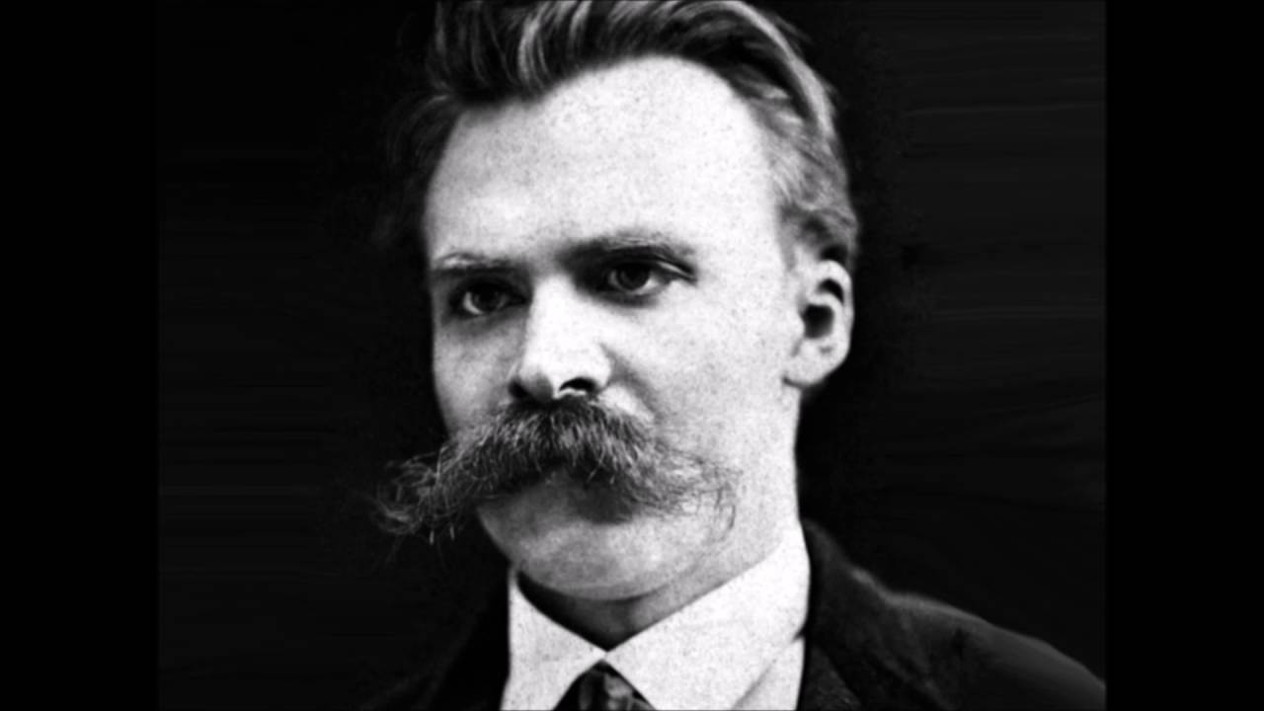
“OOP is Dead”
“OOP is Dead”
- The Internet, 2011

Slide 6

What is Pythonic?

Slide 7
What is Pythonic?
/* ANSI C */
typedef struct Pixel_t{
unsigned char r;
unsigned char g;
unsigned char b;
} Pixel_t;
#pragma alias(image,img_ptr)
register Pixel_t * _Restrict img_ptr = &image;
for (uint32fast_t i = 0; i < descriptor.height; ++i) {
for (uint32fast_t j = 0; j < descriptor.width; ++j) {
img_ptr = image[i*descriptor.width+j] ;
register avg = (img_ptr->r + img_ptr->g + img_ptr->b)/3;
img_ptr->r = avg;
img_ptr->g = avg;
img_ptr->b = avg;
}
}

Slide 8
What is Pythonic?
// C++17
for (auto[&r,&g,&b] : image)
r = g = b = (r + g + b)/3;

Slide 9
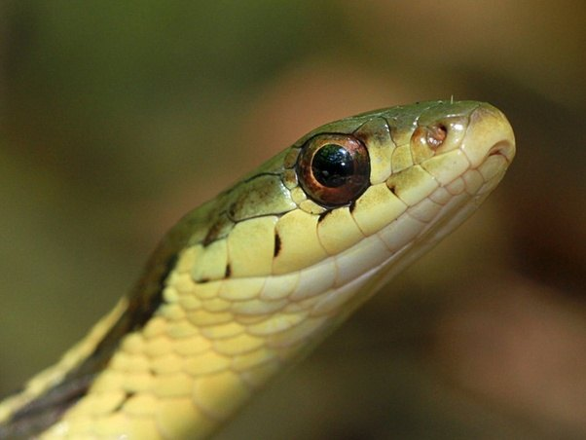

Pythonic VS Magical

Slide 10
Pythonic or Magical?
// C++11 & Boost library thread pool
#include <ctpl.h>
#define N 64
ctpl::thread_pool p(N);
double partial_sum[N] = {0};
vector<future<void>> results(N);
/*Launch threads */
for (int j = 0; j < N; ++j)
/* Partial sum lambda */
results[j] = p.push([&partial_sum, j](int){
for(long long k=j*WORKLOAD; k<(j+1)*WORKLOAD*; ++k)
partial_sum[j]+=(k % 2 ? -1.0 : 1.0) / (2.0 * k + 1.0);
});
double final_result = 0.0;
for (int j = 0; j < N; ++j)
final_result+=results[j].get();

Slide 11
Pythonic or Magical?
// C & OpenMP
#include <omp.h>
omp_set_num_threads(96);
/*Initialize sum */
double sum = 0.0;
/* Approximate pi/4 */
#pragma omp parallel
{
#pragma omp for reduction(+:sum)
for (long long k = 0; k < N; ++k) {
sum += (k % 2 ? -1.0 : 1.0) / (2 * k + 1);
}
}
/* Multiply by four to approximate pi */
result = 4 * sum;

Slide 12
Pythonic
High entropy
Concise
Minimalistic
Readable
“Short and sweet”

Slide 13






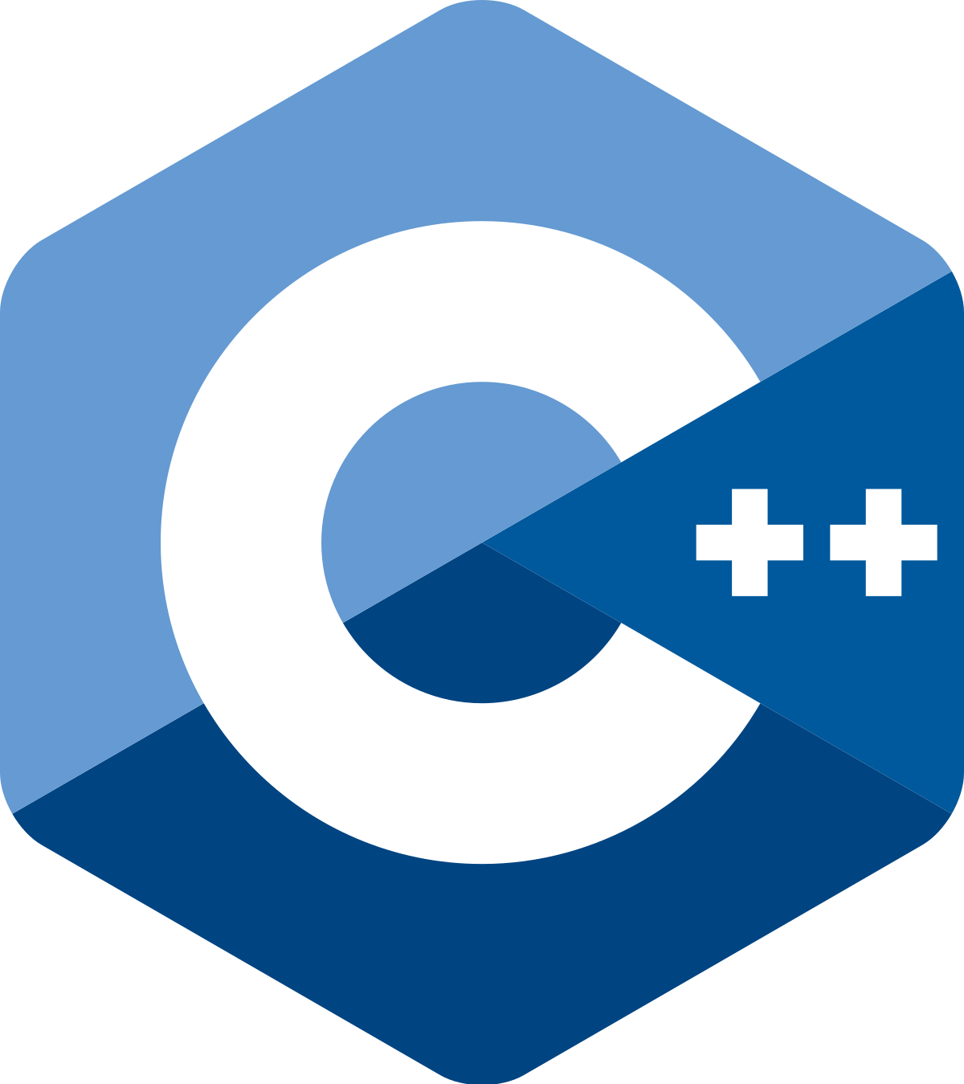

Pythonicness
C Python
Numpy
Numba
Cython
Python C++
Pro*C
Performance

Slide 14
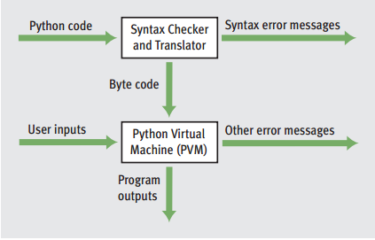
How Python works (generally)

Slide 15
Top Slowdown Factors in Python
Dynamic variables
Flexible datatypes
Interpreter latency
Sequential execution

Slide 16
Solutions
Antidotes
Dynamic variables -> Cython
Flexible datatypes -> Numpy
Interpreter latency -> Numba
Sequential execution -> Multi-threading

Slide 17
General Pro-tips I won’t be covering
Use the collections library
Use generators instead of lists
Use selective imports
Use profile-guided compilation for your C dependencies
Use manual garbage collection when it makes sense

Slide 18
Numba: Magical speedups for Python
JIT compilation
Multi-threading and multi-processing
GPU-assisted execution

Slide 19
Other Technologies
Tensorflow: A more powerful tensor library
Dask: Distributed Python
Pyrex: Basically the same thing as Cython, but harder and less popular

